Slide 1


Slide 2


Let’s Talk About
New Product Launch

Slide 3


Slide 4

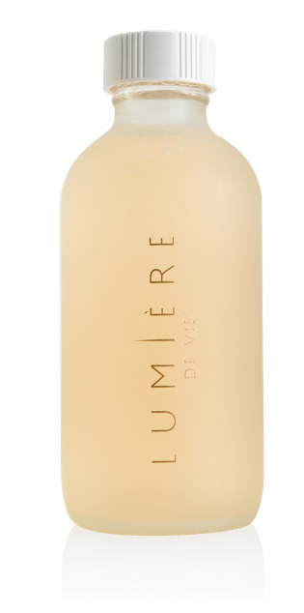
Gently cleanses and conditions skin while removing makeup and impurities
Waterless formula that does not require rinsing
Perfect for everyday use and to remove stubborn full face makeup looks
Formulated with micelle molecules, this cleanser does not use alcohol or harsh chemicals and therefore leaves behind a glowing, hydrated finish
Code: SG12216 | UC: S$ 48.50 | SR: S$ 68.00 | BV: 24

Slide 5

key ingredients found in:
· A gentle cleansing agent that
imparts a pleasant skin feel and
also has skin conditioning emollient
properties that may help the skin
feel smoother and softer.
PEG-6 CAPRYLIC/
CAPRIC
GLYCERIDES
· Allantoin has anti-irritant properties,
which help protect and soothe your
skin, leaving it feeling softer
and smoother.
ALLANTOIN

Slide 6
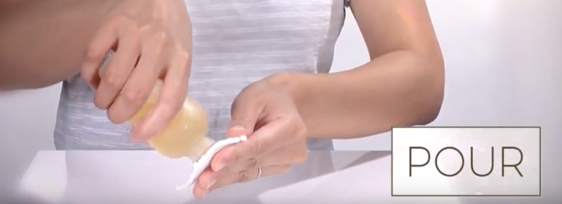
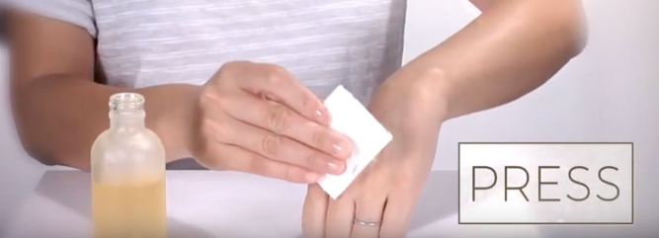
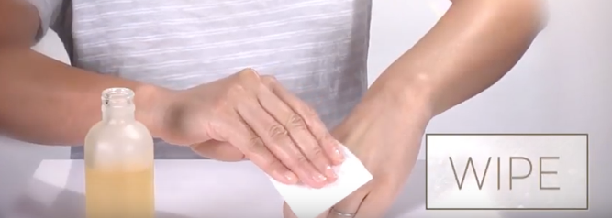
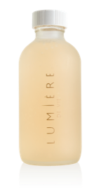
1
2
3

Slide 7
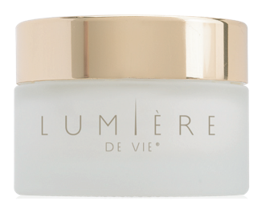
Designed to brighten, hydrate and prevent
Visibly reduces the appearance of age/dark spots and hyperpigmentation
Innovative formula utilises tranexamic acid to brighten and restore the skin’s natural radiance
Helps reduce sebum (oil) build up while leaving the skin feeling flawless and healthy
Moisturises to give skin a smoother and softer appearance
Code: SG12214 | UC: S$ 87.00 | SR: S$ 121.00 | BV: 45

Slide 8

key ingredients found in:
Tranexamic Acid is a synthetic derivative of the amino acid lysine and is classified as a skin conditioning agent. Tranexamic acid also has skin brightening properties that help reduce the appearance of dark spots for a more even-looking complexion.
TRANEXAMIC ACID
Potassium Azeloyl Diglycinate is a skin conditioning ingredient formed from a combination of azelaic acid and the amino acid glycine. Potassium Azeloyl Diglycinate helps brighten the skin and reduce the appearance of dark spots for a more radiant looking complexion.
POTASSIUM AZELOYL DIGLYCINATE
ADVANCED MOISTURE
COMPLEX
(GLYCERIN & WATER & SODIUM
PCA & UREA & TREHALOSE &
TRIACETIN & POLYQUATERNIUM-51
& SODIUM HYALURONATE)
This blend of ingredients provides rapid and long-term skin hydration, helping to keep the skin looking smooth and soft.
Notes:
Clinical Studies
Reported that a cream containing 2% tranexamic acid improved the appearance of skin pigmentation in 80% of the study volunteers after 8 weeks
A similar study published earlier this year also reported that topical application of 2% tranexamic acid for 12 weeks reduced the appearance of facial hyperpigmentation
Reduces the appearance of darkened areas of the skin throughout a 12-week study period
Does not cause irritation as some other common ingredients do
Super cream contains 2.5% tranexamic acid, as compared to the 2% in the studies

Slide 9
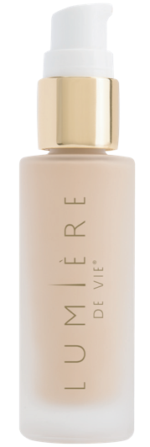
Instantly softens the appearance of pores and wrinkles
One universal shade designed to adjust to the skin’s natural complexion allowing flawless, light coverage
Infused with peptides that help reduce the appearance of wrinkles, moisturise and eliminate shine
Can be worn alone for a no-makeup makeup look or under your favourite Motives® foundation for the perfect base
Promotes a smooth finish, reducing makeup slippage into fine lines
Code: SG12215 | UC: S$ 64.50 | SR: S$ 90.00 | BV: 33

Slide 10

key ingredients found in:
Sasccharide Isomerate is a polysaccharide ingredient with mattifying and moisturising properties. It absorbs excess oil on the skin and reduces skin shine, while helping to maintain skin hydration.
ABERMAT
(WATER & SACCHARIDE)
Derived from phosphatidyl choline, this unique ingredient (lysophosphatidic acid) has been shown to reduce the appearance of visible pores, thereby helping enhance the skin’s complexion.
DISAPORE 20
(LECITHIN & LYSOPHOSPHATIDIC ACID & LYSOLECITHIN)
Bresderm is a plankton-derived polymer of carbohydrates. This ingredient is designed to rapidly fill the furrows and small wrinkles of the skin, thus temporarily reducing the appearance of fine lines and wrinkles for a smoother looking complexion.
BRESDERM
(WATER & SACCHARIDE
ISOMERATE)
Tetrapeptide-21 is a peptide sequence based on the skin’s own structure. This unique peptide helps reduce the appearance of fine lines and wrinkles, improves skin roughness and supports elasticity.
TEGO PEP 4-17
(GLYCERIN & BUTYLENE GLYCOL
& WATER & TETRAPEPTIDE-21)

Slide 11
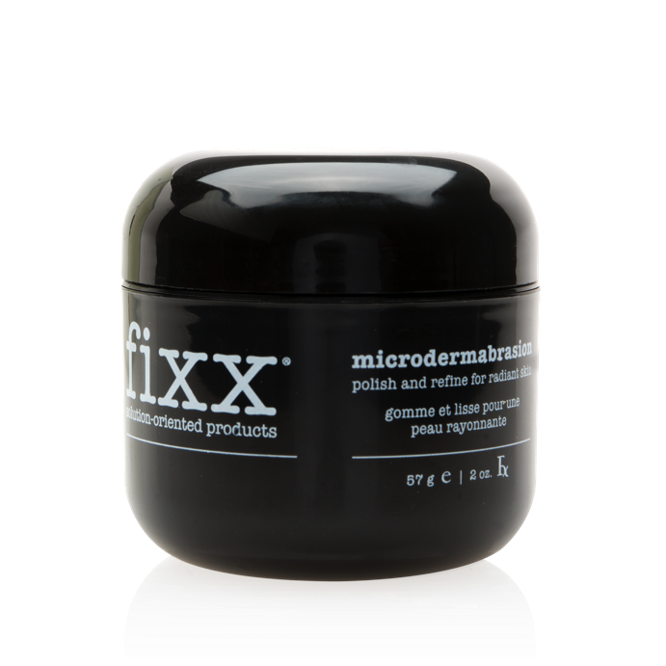
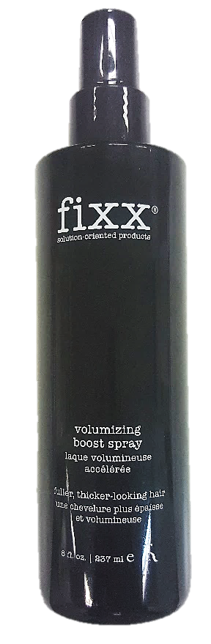
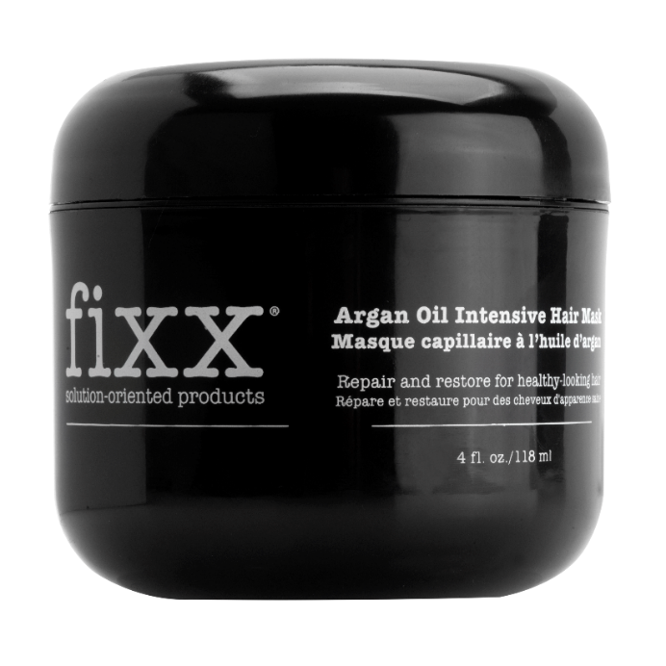
Microdermabrasion
SG12525
UC: S$ 29.50| SR: S$ 41.00
BV: 14
Argan Oil Intensive Hair Mask
SG12529
UC: S$ 27.00 | SR: S$ 38.00
BV: 11
Volumizing Boost Spray
SG12516
UC: S$ 19.50 | SR: S$ 27.00
BV: 9
Notes:
icrodermabrasion
Supports normal skin renewal for radiant-looking skin
Polishes the skin with skin-revitalising exfoliators which gently buff away dead skin and unclog pores
Helps moisturise and soothe the skin with aloe vera
Contains marine-derived ingredients to help soothe skin
Helps promote a more even-toned complexion
Argan Oil Intensive Hair Mask
Repairs and smoothes damaged hair cuticles and fibres
and detangles for increased hair strength
Reduces loss of hair colour and protects luminosity
Moisturises for softer-looking hair
Volumizing Boost Spray
Contains wheat proteins to help volumise and texturise the hair
Humidity resistant
Helps manage hair
Infused with vitamins and proteins to help condition the hair

Slide 12

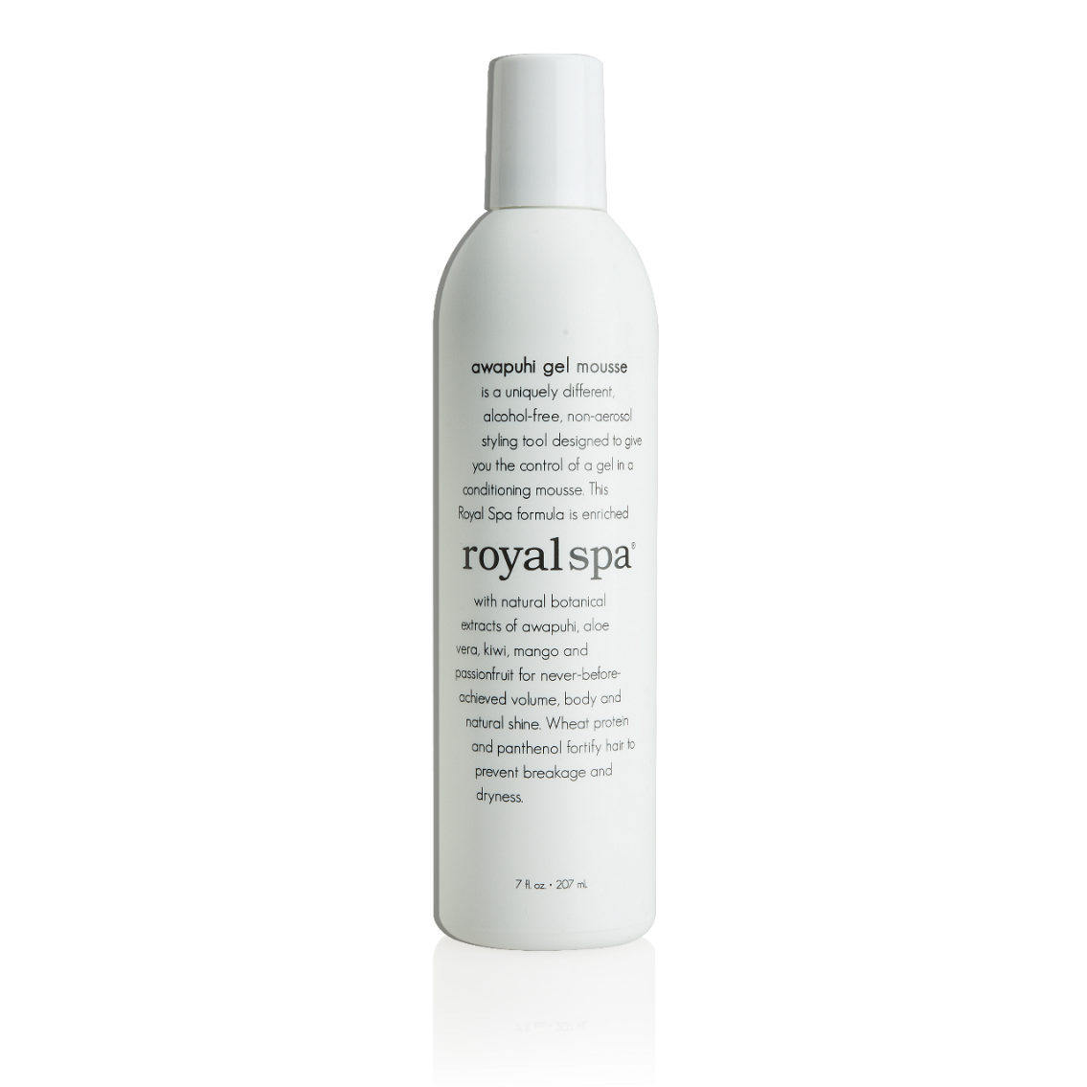
Royal Spa™
Awapuhi Mousse
Code: SG12021
UC: S$ 19.50 | SR: S$ 27.25
BV: 5 | IBV: 5
Notes:
Awapuhi Mousse
Provides the control of a gel in a conditioning, styling mousse
Enriched with natural botanical extracts of awapuhi, aloe vera, kiwi, mango and passion fruit with whole wheat protein and panthenol
Promotes volume, body and natural shine
Helps prevent breakage and dryness
Alcohol-free
Non-aerosol
pH-balanced
Free of heavy oils that weigh hair down

Slide 13

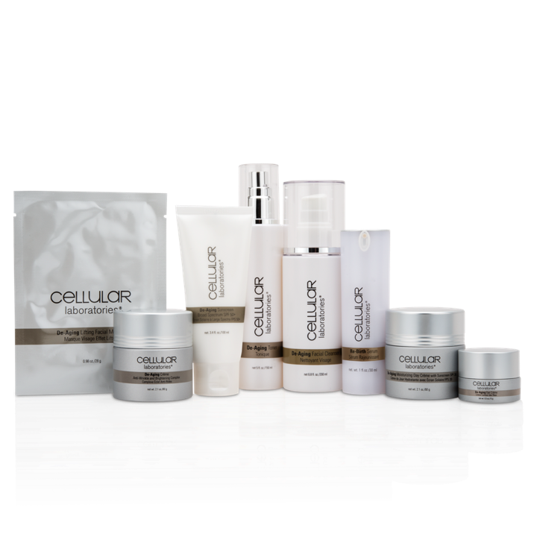
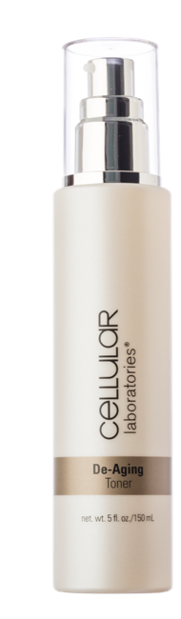
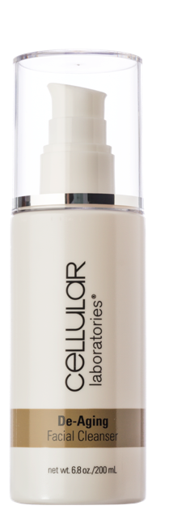
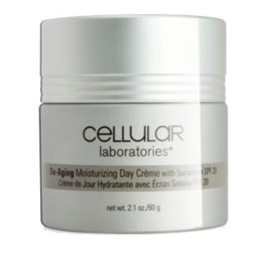
Save
25%
Save
21%
Full Regime Kit
SG11211
UC: S$ 435.50 | SR: S$ 609.00
BV: 245
Value Kit
SG11212
UC: S$ 138.00 |SR: S$ 192.00
BV:65
Notes:
Regime Kit
Save 25% versus purchasing individually
Products work in unison to cleanse, tone, moisturise and lift your skin
Contains
Facial Cleanser
Toner
Re-birth Serum
De-aging Day Crème with SPF20
De-aging Crème
De-aging Eye Crème
De-aging Facial Lifting Masque
De-aging Sunscreen Broad Spectrum with SPF 50+
Value Kit
Save 21% versus purchasing individually
Products work in unison to reduce residue and excess oil on the skin, reduce the appearance of fine lines and wrinkles and protect skin from UVB rays
Contains
Facial Cleanser
Toner
De-aging Day Crème with SPF20

Slide 15
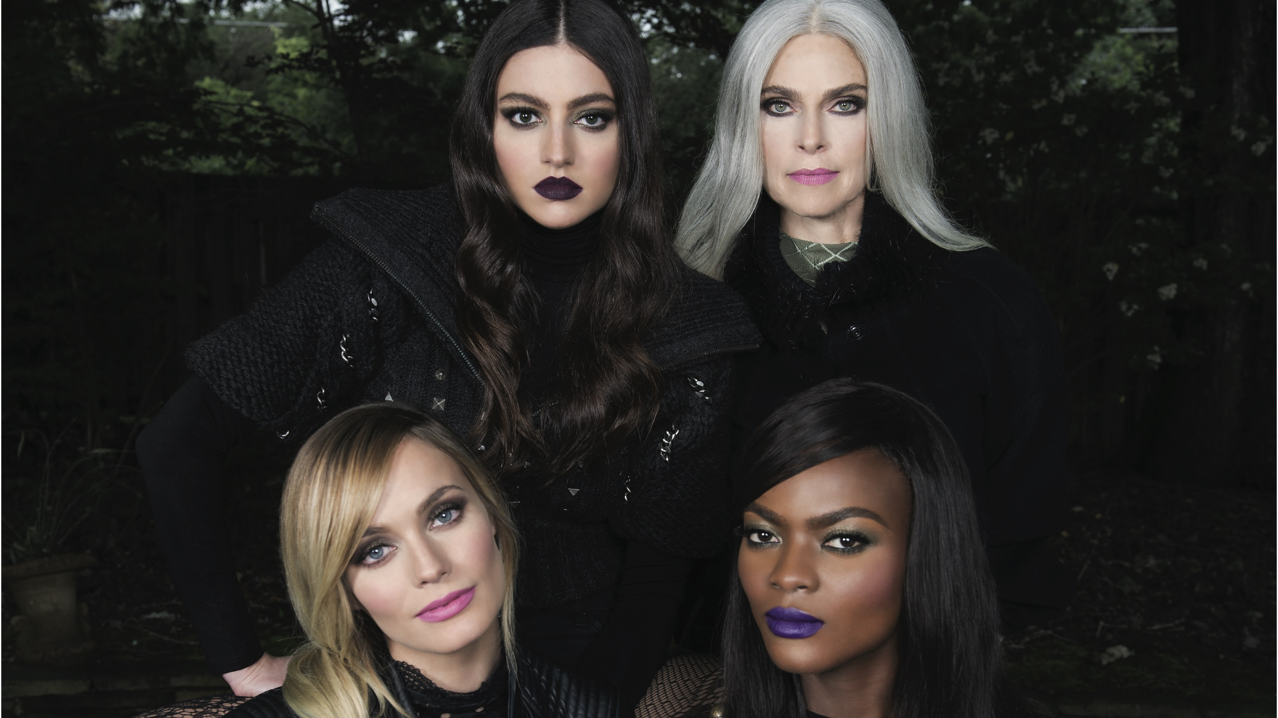

Slide 16
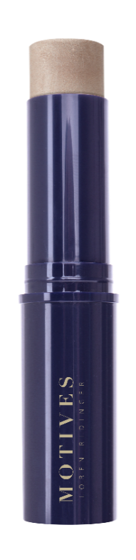
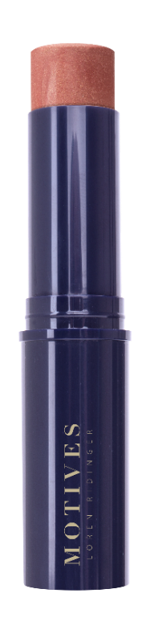
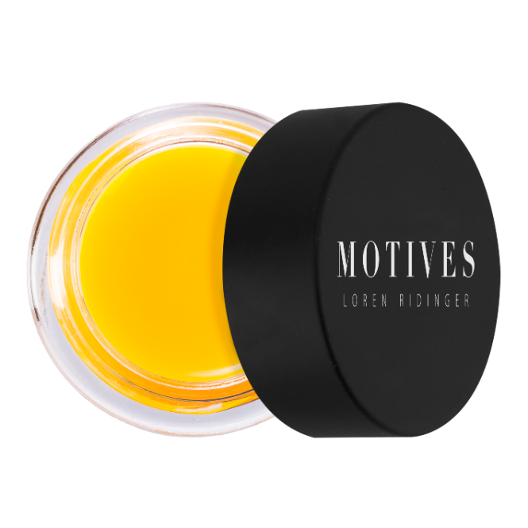
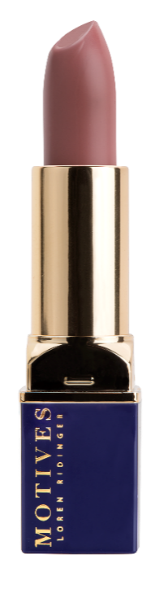
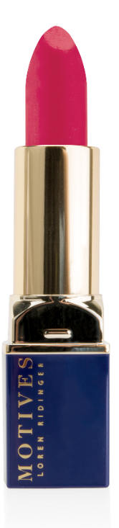
Motives® Vitamin C Lip Treatment
Motives® Ultra
Matte Lipstick
Motives® Shimmer Stick
Seduced
SG211UML
Caress
SG208UML
Moonlight
SG200MSS
Sunkissed
SG201MSS
SG500MLT
UC: S$ 21.25 | SR: S$ 29.95
BV: 10
UC: S$ 20.50 | SR: S$ 30.00
BV: 10
UC: S$ 25.00 | SR: S$ 35.00
BV: 12
Notes:
Vit C Lip Treatment
Helps lips resist chapping
Hydrates and protects lips
Gives you a smooth canvas for Motives Lipsticks
Shimmer Stick
Intensely pigmented, matte shades
Creamy texture ensures smooth application
Stays true to colour for extended periods of wear
Paraben free
Ultra Matte Lipstick
2 new colours
Intensely pigmented, matte shades
Creamy texture ensures smooth application
Stays true to colour for extended periods of wear
Paraben free

Slide 17
Motives® Shimmer Powder
Rose Diamond
SG200GSP
Starshine
SG201GSP
Goddess
SG202GSP
Bombshell
SG203GSP
UC: S$ 25.75 | SR: S$ 36.00 | BV: 12
Notes:
Lightweight, shimmering powder that reflects light for a beautiful natural glow
Apply to cheek bones, eyelids or shoulders to create the ideal luminous look
Four shades that range from rose gold to bronze, these are ideal for any skin tone in any season
Paraben, talc and fragrance free

Slide 18



STAY UPDATED WITH
MOTIVES® COSMETICS
MOTIVESMASG
MOTIVESCOSMETICS

